Slide 1
What are the modern computational techniques employed for nuclear physics engineering?
By: Avery Vallée-Vézina
Notes:
Hello everybody,
Today I will be presenting something that always had a little bit of mystery behind it… Especially in terms of computer science.
So, I asked myself, “What are the modern computational techniques employed for nuclear physics engineering”?

Slide 2
Agenda
Introduction:
  Overview of the physics required for understanding the further sections
Sections 1:
  LLMs in nuclear physics research
Section 2:
  Use case of computational models
Conclusion:
  Overview of key findings, scope of my research, and where it’s headed.
Notes:
So, lets go over this presentation’s agenda.
We’ll start by introducing what the scope of the presentation.
Then we’ll investigate AI in nuclear physics research.
After words we’ll look at a computational model to simulate a large variety of problems.
The key points found in my research, scope of my research, and where it’s headed?

Slide 3
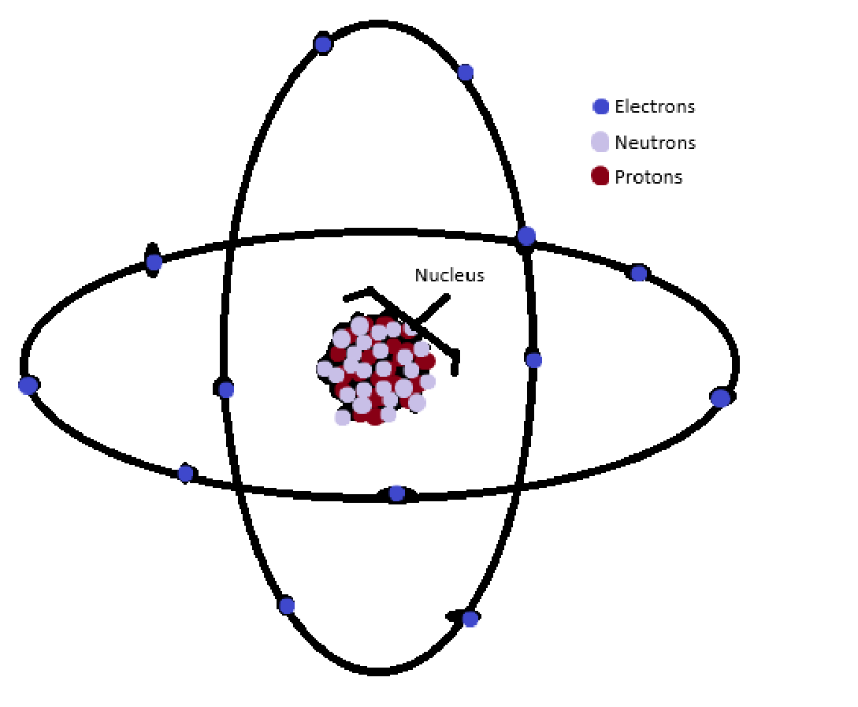
Introduction
Dissecting my topic question (Revisit)
Notes:
Let's dissect my topic question for a minute.
What do I mean by “Computational methods in nuclear physics engineering”.
To make sense of it I’ll go over key concepts before going into the presentation.
So first to answer at a high level, what do I mean by nuclear physics?
Here is a quick overview of the structure of an atom.
It has electrons, neutrons, and protons. The center mass of the atom is called the nucleus, and it is composed of protons and neutrons.\
Nuclear physics simply refers to the science of the forces that are within the nuclei of atoms
Quote: “These forces are within the nuclei of the atoms” Feynman lecture series Vol 1 page 12-12

Slide 4
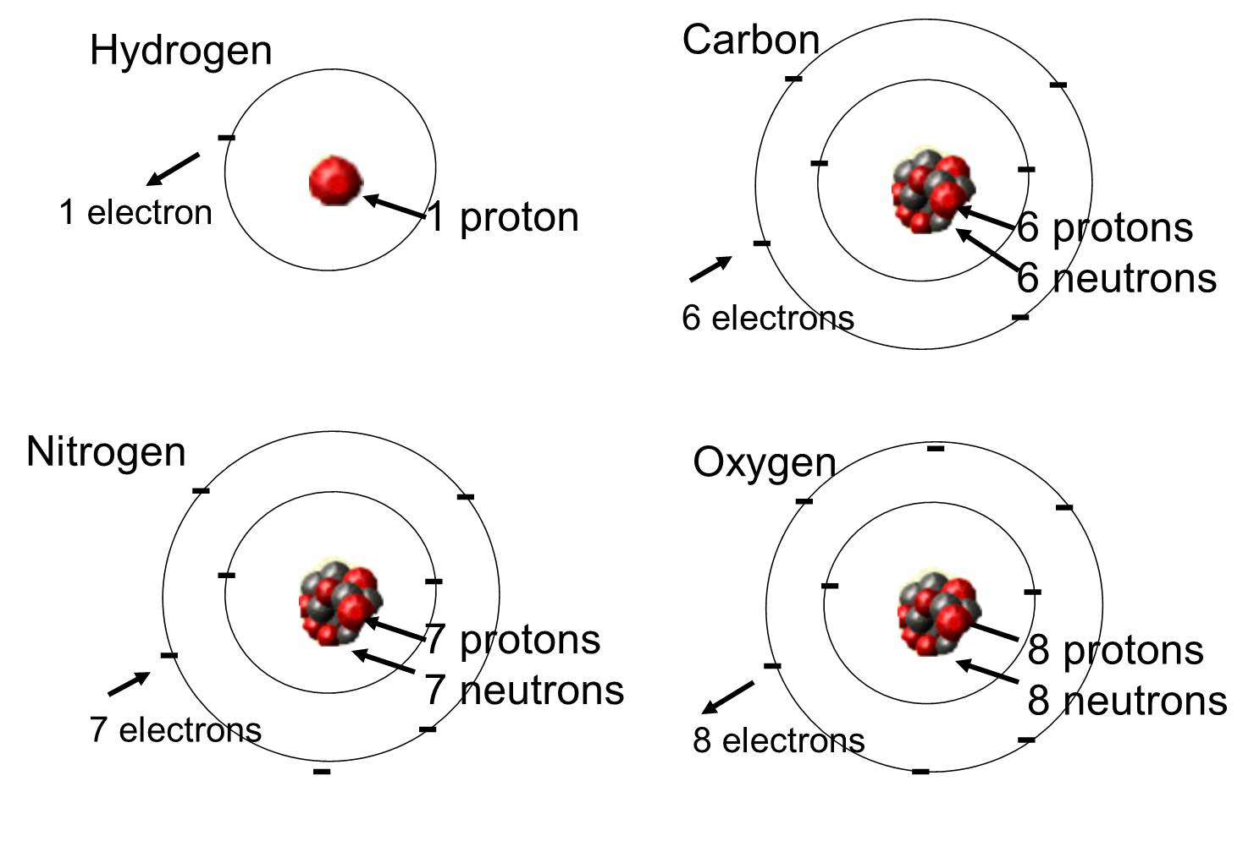
Notes:
Depending on how many protons, neutrons, and electrons you have, you’re create different elements. If we add a sufficient amount, you’ll eventually create unstable elements in the form of radioactive elements.

Slide 5
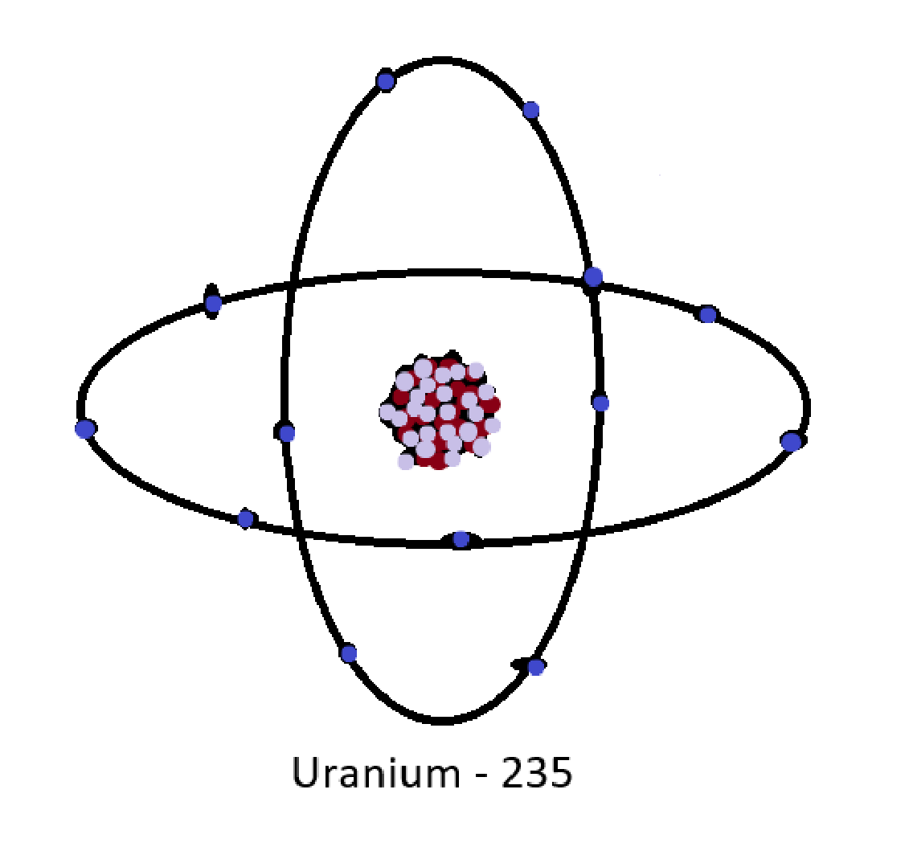
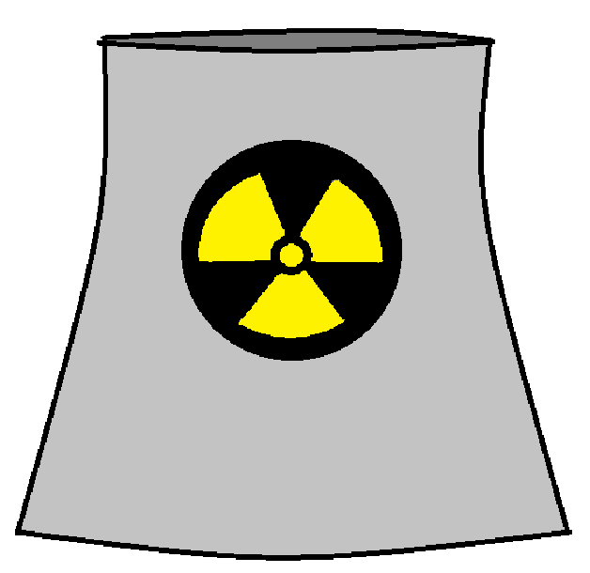
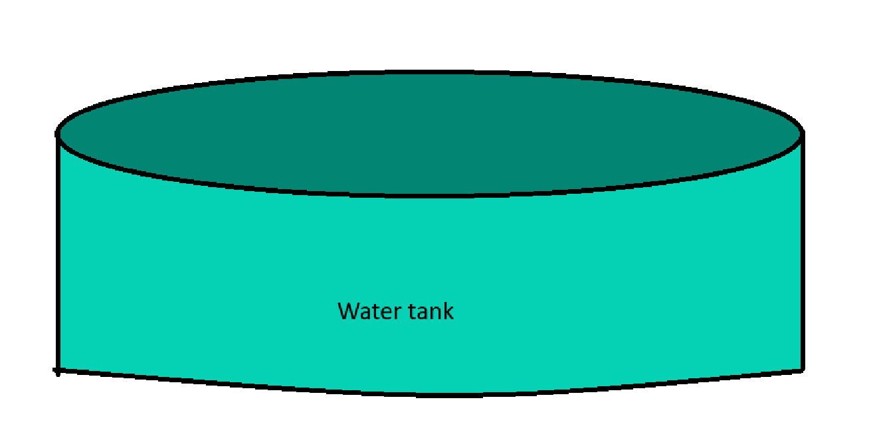
Introduction
Scope of my research
Notes:
TODO: Add animations slowly introducing the images as I reveal the scope
Although dangerous, radioactive elements produces vast amount of energy.
But how does it do that? Put simply, we take radioactive materials and create a series of controlled reactions.
Each reactions causes energy in the form of heat, which heats up the water tank creating vapor.
The vapor rises and spins a big turbine.
-------
My research will focus on the computational avenues around the controlled reactions of the radioactive material.
My first thought was, “How is it being researched”.
Turns out people are already asking that question, no surprise, but the reality is that we are constantly trying to find new ways to optimize workflow, and nuclear researchers are no different.

Slide 6
Section 1
Large Language Models in nuclear physics research

Slide 7
Section 2
Monte Carlos Simulations

Slide 8
Conclusion

